Slide 1
Multinomial Naive Bayes classifier Text Classification Model

Slide 2
TABLE OF CONTENTS
01
PROBLEM
CHOOSE MODEL
BUILD MODEL
EVALUATE MODEL
02
03
04
What is the problem that you are attempting to solve?
What is the ML paradigm that you will be working with?
How data processing and model implementation is done?
What are limitations & Improvement Strategies?

Slide 3
PROBLEM
While not inherently a problem, our objective is to create a solution that seamlessly processes user-provided descriptions and intelligently suggests the appropriate Linux or CMD command based on the context of the request. The aim is to offer users an efficient and user-friendly means to obtain the relevant command corresponding to their described task or query.

Slide 4
CHOOSE MODEL
The employed model is a Multinomial Naive Bayes classifier, operating within the realm of supervised learning. Specifically tailored for classification tasks, this model is designed to categorize textual data, making it particularly well-suited for text classification. In this context, the labels correspond to various commands, and the features used for training and prediction are the textual descriptions associated with each command. Each command is distinguished by six distinct descriptions, contributing to the model's capacity to discern patterns and relationships within the text data.

Slide 5
Multinomial Naive Bayes VS Bayesian Classifier
 | Multinomial Naive Bayes | Bayesian Classifier
Type | specific type of Naive Bayes classifier | more general term that encompasses various classifiers based on Bayesian principles
Use Case | Primarily used for classification tasks, especially in the context of text data. | Can be used for both classification and regression tasks across different domains.
Assumption | It assumes that features (in this case, words or term frequencies) are categorical and that their occurrence follows a multinomial distribution. | Applies Bayesian probability principles to make predictions. This can include different types of probability distributions, not necessarily the multinomial distribution.
Application | Commonly applied in natural language processing (NLP) tasks like text classification and spam filtering. | Used in various machine learning tasks, including Bayesian networks, Bayesian linear regression, and other probabilistic models.

Slide 6
BUILD MODEL
Choose Dataset:
Work on Dataset:
Build Model:
Build Interface for Model:
Select a relevant and labeled dataset for your machine learning task.
Clean, preprocess, and explore the dataset to prepare it for model training.
Train machine learning model using the prepared dataset to make predictions.
Develop a user-friendly interface to interact with and utilize the trained model

Slide 7
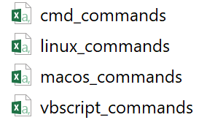
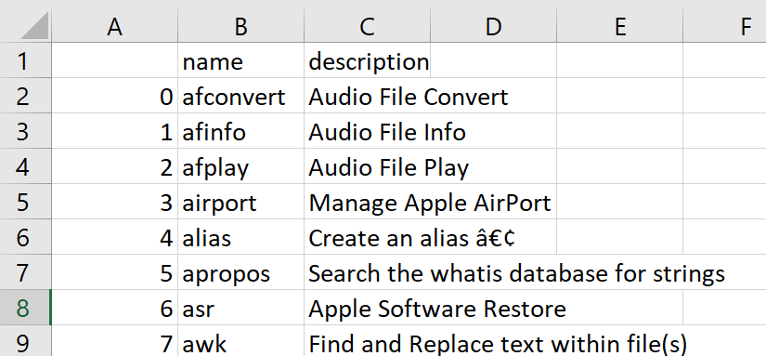
BUILD MODEL-1: Choose Dataset
The initial dataset was sourced from Kaggle and can be accessed through the following link: https://www.kaggle.com/datasets/vaibhavdlights/linuxcmdmacos-commands. This downloaded dataset comprises four CSV files, each corresponding to command listings for CMD, Linux, macOS, and VBScript. Within each CSV file, commands are accompanied by a single description for clarity and understanding.

Slide 8
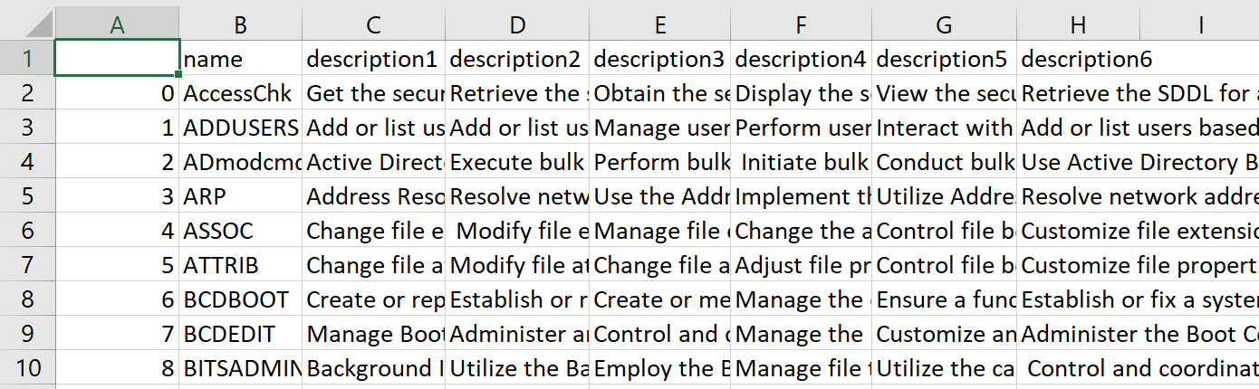
BUILD MODEL-2: Work on Dataset
Initially, each command in the dataset had only one description, which was deemed insufficient. To enhance the dataset's richness, five additional descriptions were added for each command, resulting in a comprehensive set of six descriptions for every individual command. Further data preprocessing and manipulations, essential for model building, were carried out within the model-building Python code.

Slide 9
BUILD MODEL-3: Build Model
Model 1:
Utilizes TfidfVectorizer for text vectorization.
Calculates and prints accuracy on the entire dataset.
Further trains the model on the test set.
Takes user input, classifies it, and outputs the top 5 predictions with probabilities.
Model 2:
Employs TfidfVectorizer for text vectorization.
Calculates and prints accuracy on the entire dataset.
Saves the trained model using joblib for future use.
Takes user input, classifies it, and outputs the top 5 predictions with probabilities.

Slide 10
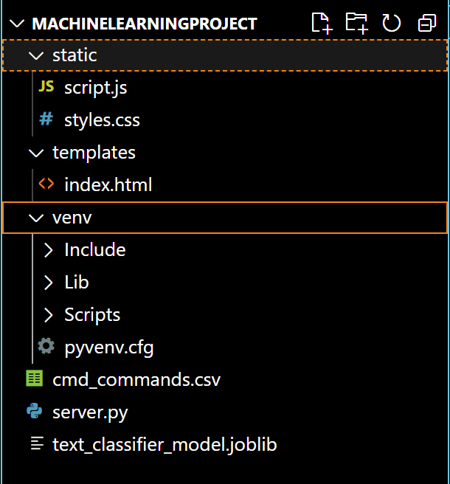
BUILD MODEL-4: Build Interface for Model
Venve: serves the purpose of creating an isolated environment for a Python project, preventing dependency conflicts with other projects, and it contains the virtual environment with its own Python interpreter copy, along with directories for libraries and scripts.
text_classifier_model.joblib: It serves as a storage file for the trained model and vectorizer, preserving their state, parameters, and learned patterns.

Slide 11
Limitations & Improvement Strategies:
Limitations
The time constraint prevented the inclusion of the entire dataset for model training.
The dataset is populated with synthetic descriptions rather than real human-generated ones.
Each command has a fixed number of descriptions (6), potentially limiting the model's exposure to varied contexts.
Improvement Strategies
Consider allocating additional time to incorporate the entire dataset, ensuring comprehensive model coverage.
Gather human-generated descriptions to enhance the authenticity and diversity of the dataset.
Allow users to contribute additional descriptions for commands through the interface, promoting a richer dataset.
Expand the interface functionality to enable users to provide their own command descriptions, fostering user engagement and dataset enrichment.
Explore alternative model architectures or methods, such as deep learning approaches, to assess their effectiveness in capturing complex relationships within the dataset.

Slide 12
THANKS

